Slide 1

Genome-Environment Associations (GEAs)
Marine Genomics S22
Week 10 – June 2nd 2022

Slide 2
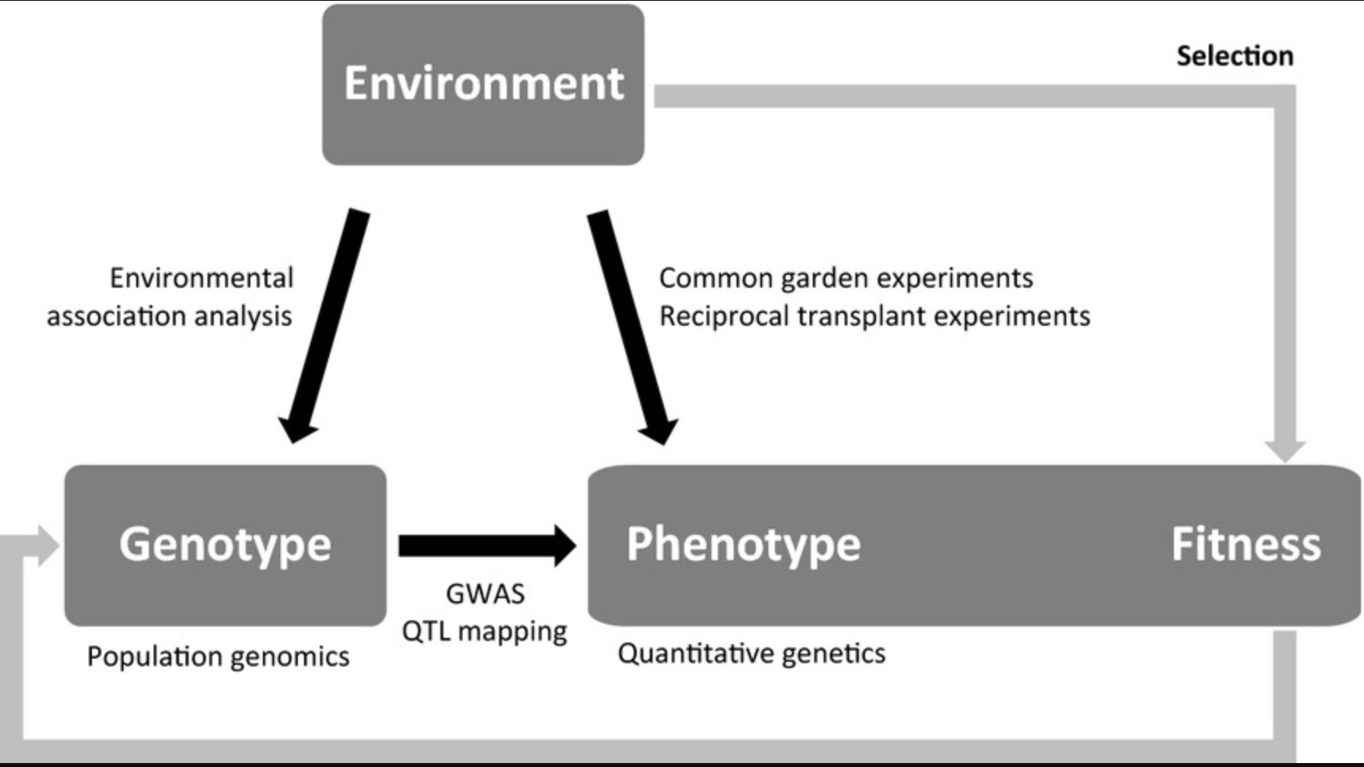
Rellstab et al. (2015)

Slide 3

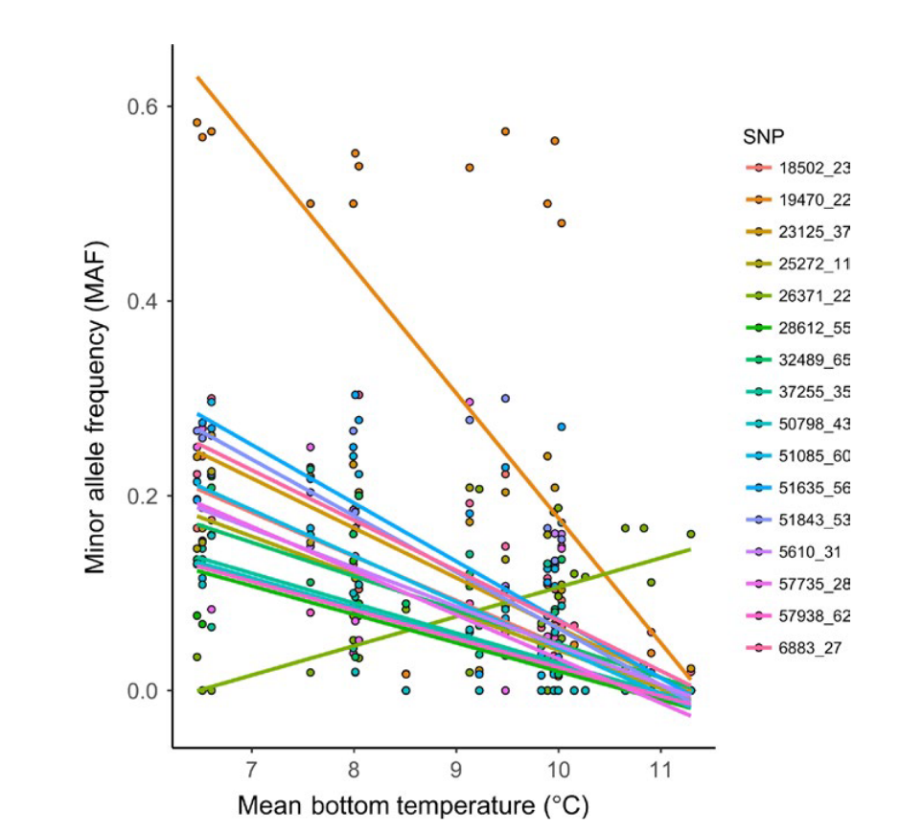
Environmental data ~ Genomic data
https://www.bio-oracle.org/explore-data.php
Xuereb et al. (2018)

Slide 4
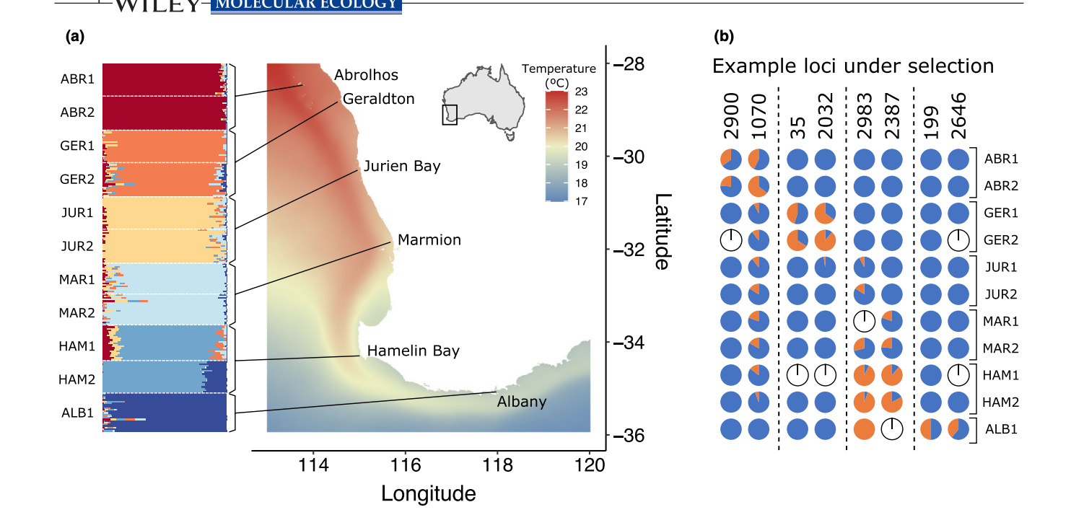
What SNPs are associated with the environment?
Vranken et al. (2022)

Slide 5
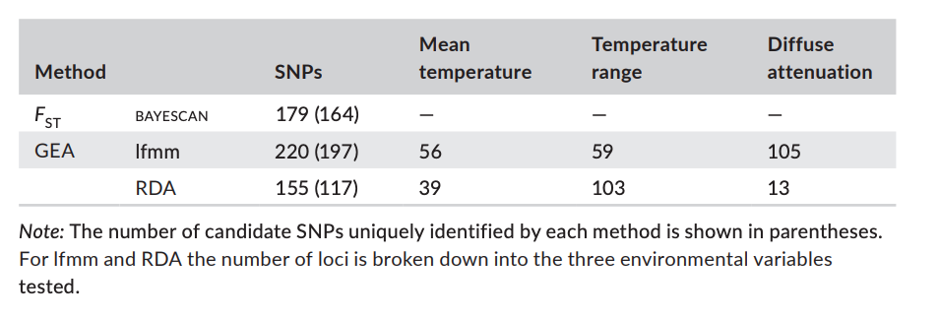
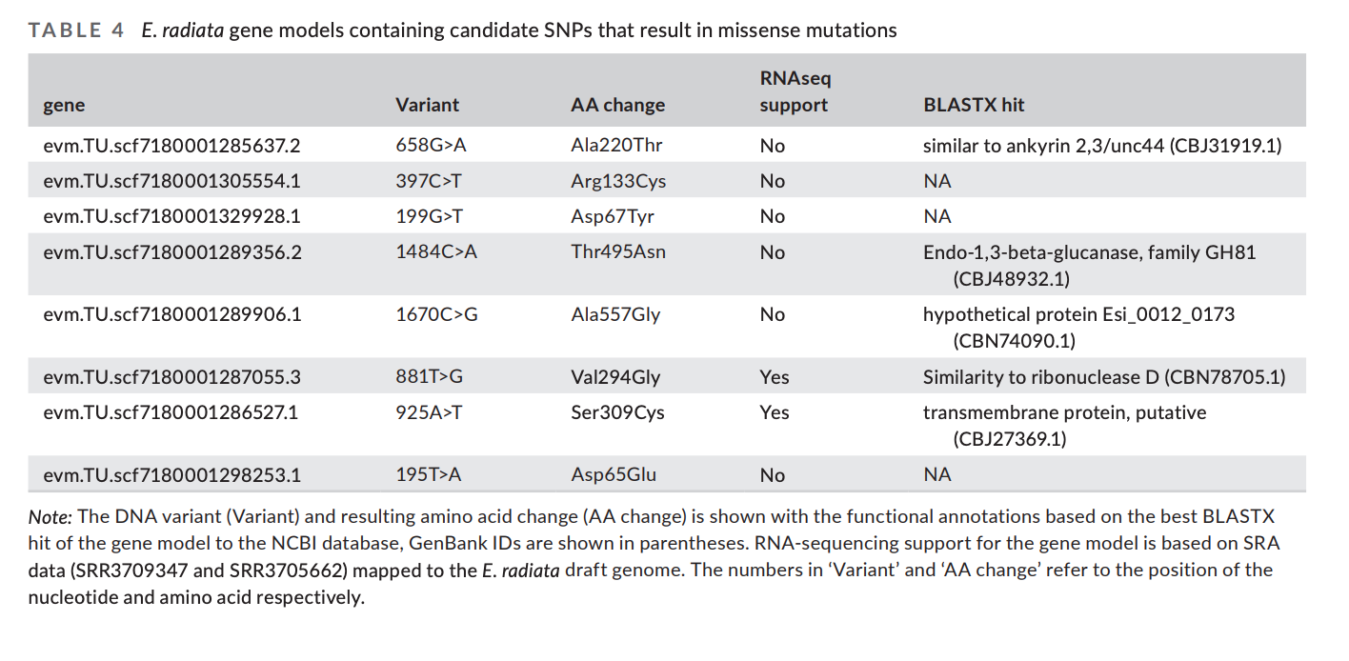

Vranken et al. (2022)

Slide 6
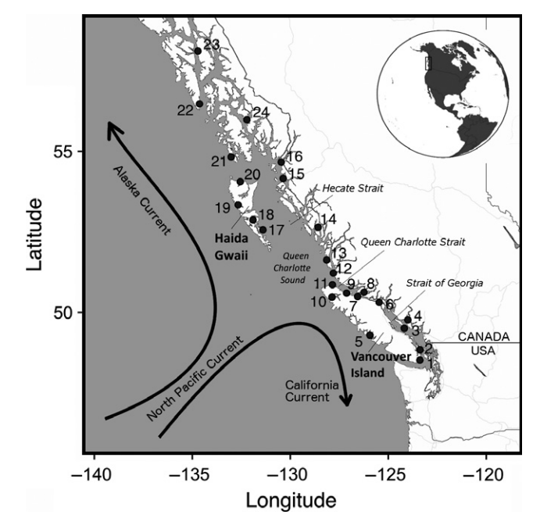
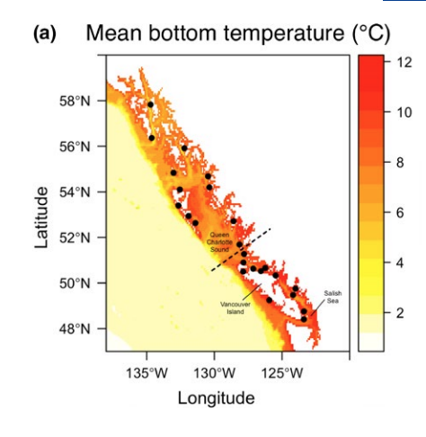
Population structure
Population structure can confound GEAs
Many GEA programs will correct for structure (via different statistical analyses)
Can also run GEAs within each pop if enough sample sites
Notes:
In structured populations, genetic signatures of selection may
be confounded with signatures of neutral (i.e., historical or demographic)
processes that may be falsely interpreted as selection
(Excoffier, Hofer, & Foll, 2009). Corrections for population structure
are thus recommended to control for signals generated by neutral
processes, although these corrections can also be overly conservative
in some cases by inadvertently removing true signals of selection
(Forester et al., 2018).

Slide 7

GEA analysis
Correlation between environmental data and genomic data
We’ll be using the R package lfmm (latent factor mixed model)
Basically, a regression model with fixed and latent effects
Y=XB^T+W+E
Fixed effects in matrix B
Latent effects in matrix W
Residual errors in E
Response variable
(genomic variation)
Environmental variable
https://academic.oup.com/mbe/article/36/4/852/5290100#138397544
Notes:
In LFMMs (Frichot et al. 2013), neutral genetic structure is introduced as a random factor with the so-called latent factors, which are similar to principal components and calculated from all available markers. The advantage of this linear approach is that the effects of environmental factors and neutral genetic structure on allele frequencies are simultaneously estimated.
a fixed effects model is a statistical model in which the model parameters are fixed or non-random quantities. This is in contrast to random effects models and mixed models in which all or some of the model parameters are random variables.
A residual is a measure of how far away a point is vertically from the regression line. Simply, it is the error between a predicted value and the observed actual value.
latent variables are variables that are not directly observed but are rather inferred through a mathematical model from other variables that are observed (directly measured).

Slide 8


Data for class today
3966 SNPs from 685 Pacific sea cucumbers

